Slide 1


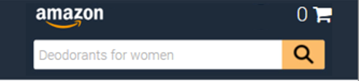
Header
Header will be full-width and will be restructured to use containers instead of big images as it is right now:
Container | PC/Tablet look | Smartphone look
1. Big container with an adjustable colour | Yes | Yes
2. Site logo (image) | Yes | Yes
3. Search bar (image + search button with an adjustable colour) | Yes | Yes
4. Deliver to (text, image, text + image, blank) | Yes | No
5. Toolbar 1 (text, image, text + image, blank | Yes (hide if insufficient page width) | No
6. Toolbar 2 (text, image, text + image, blank) | Yes (hide if insufficient page width) | No
7. Cart (text + Unicode character for cart) | Yes | Yes
8. Banner (text, image, text + image, blank) | Yes (hide if insufficient page width) | No
1
2
3
8
7
4
5
6
2
7
1
3

Slide 2
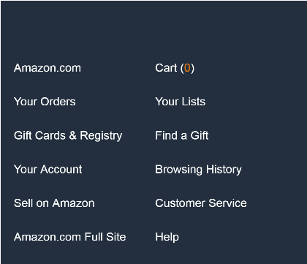
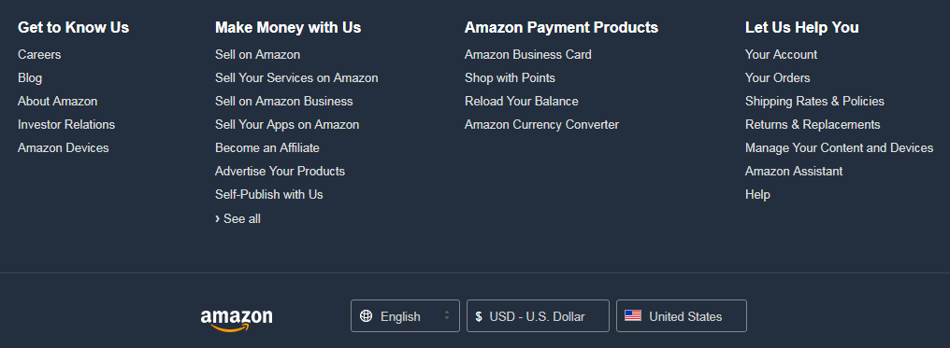
Footer
Footer will be full-width and will be restructured to use containers instead of big images as it is right now:
1. Back to top section with adjustable colour
2-5. Footer section with 4 columns
Columns could fit text, image, text + image or could be left blank
Columns 2-3 are visible always, columns 4-5 would hide based on the device screen size
6. One full-width container that would host an image. We need 4 different images based on screen size:
Mobile Devices: <= 600px
Tablet Devices: > 600px
Desktop Devices: > 992px
Large Desktop Devices: > 1200px
In case the image container or all column containers are empty – they will not be displayed at all.
1
1
Back to top
Back to top
2
3
2
3
4
5
6
6

Slide 3
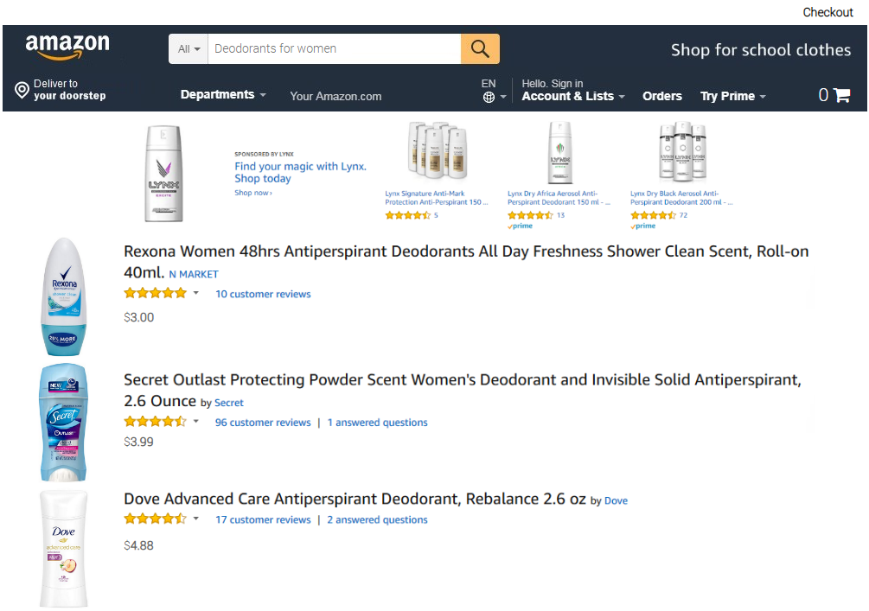
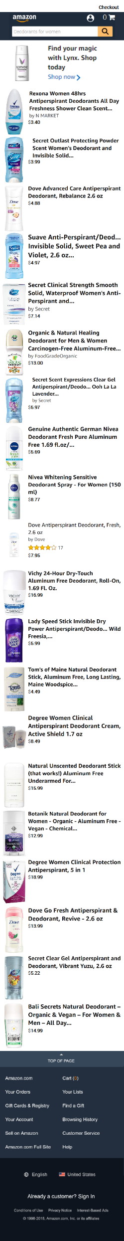
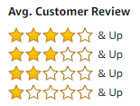
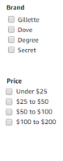
Product list
We need to introduce a grid view of the product list for PC/Tablet. Grid/row view will be set from the script, respondents will not have the option to select the view they need
We need to introduce the filtering on Number of stars, Brand, Price:
For PC/Tablet, the filter pane will be placed on the left of the simulation
For Smartphone, there will be a filter option just below the banner. When clicking on it, a filter pane will appear on top of the search results
Each of the filters can be turned on and off inside the script
Number of stars filter will be preset and could not be changed. Brand and Price will be delivered for each project and will need to allow up to 10 multi-answer positions each.
<< Back
Filter >>

Slide 4
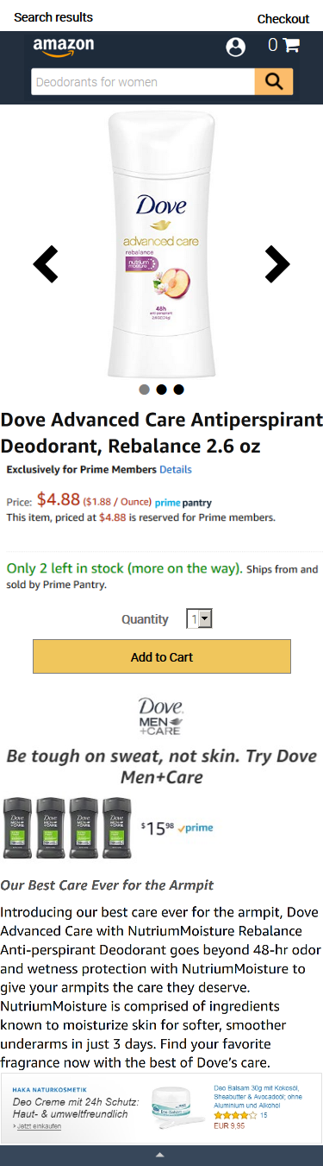
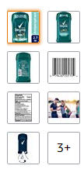
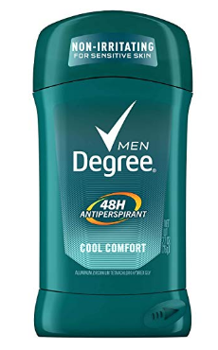
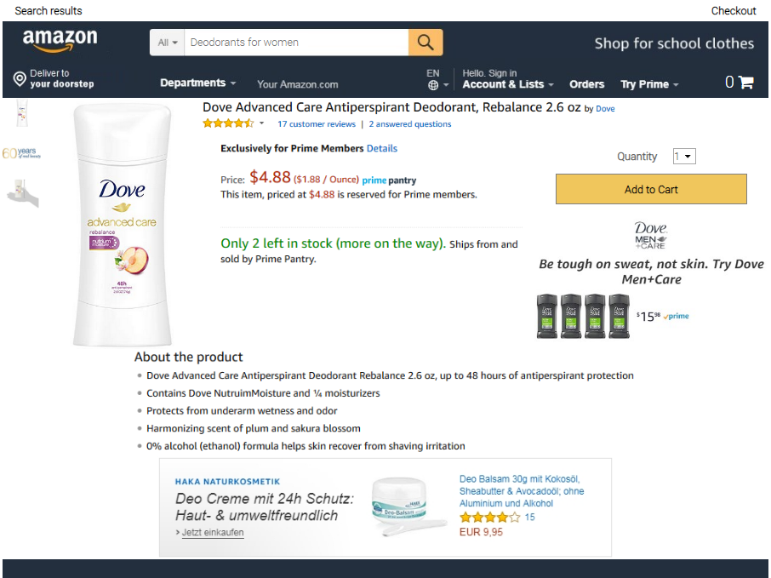
Product page
Product page layout to be updated to allow bigger product image – only on PC/Tablet. For smartphone the current layout should be kept.

Slide 5
Colours
In terms of colors (and thinking on having a general look), we will need to define:
3 colors for the search bar:
Under the word ‘All’,
background for the search bar
under the magnifier pictogram
4 colors for the general look:
background color for header
main container
footer
‘back to top’ button.

